Slide 1

Momo Medical Week 15
Salah Abdulkader, Theo van den Berg, Roy Duivenvoorden, Nick Keereweer, Floris van Lingen

Slide 2
Table of contents
The project
What did we do?
What are we going to do?

Slide 3
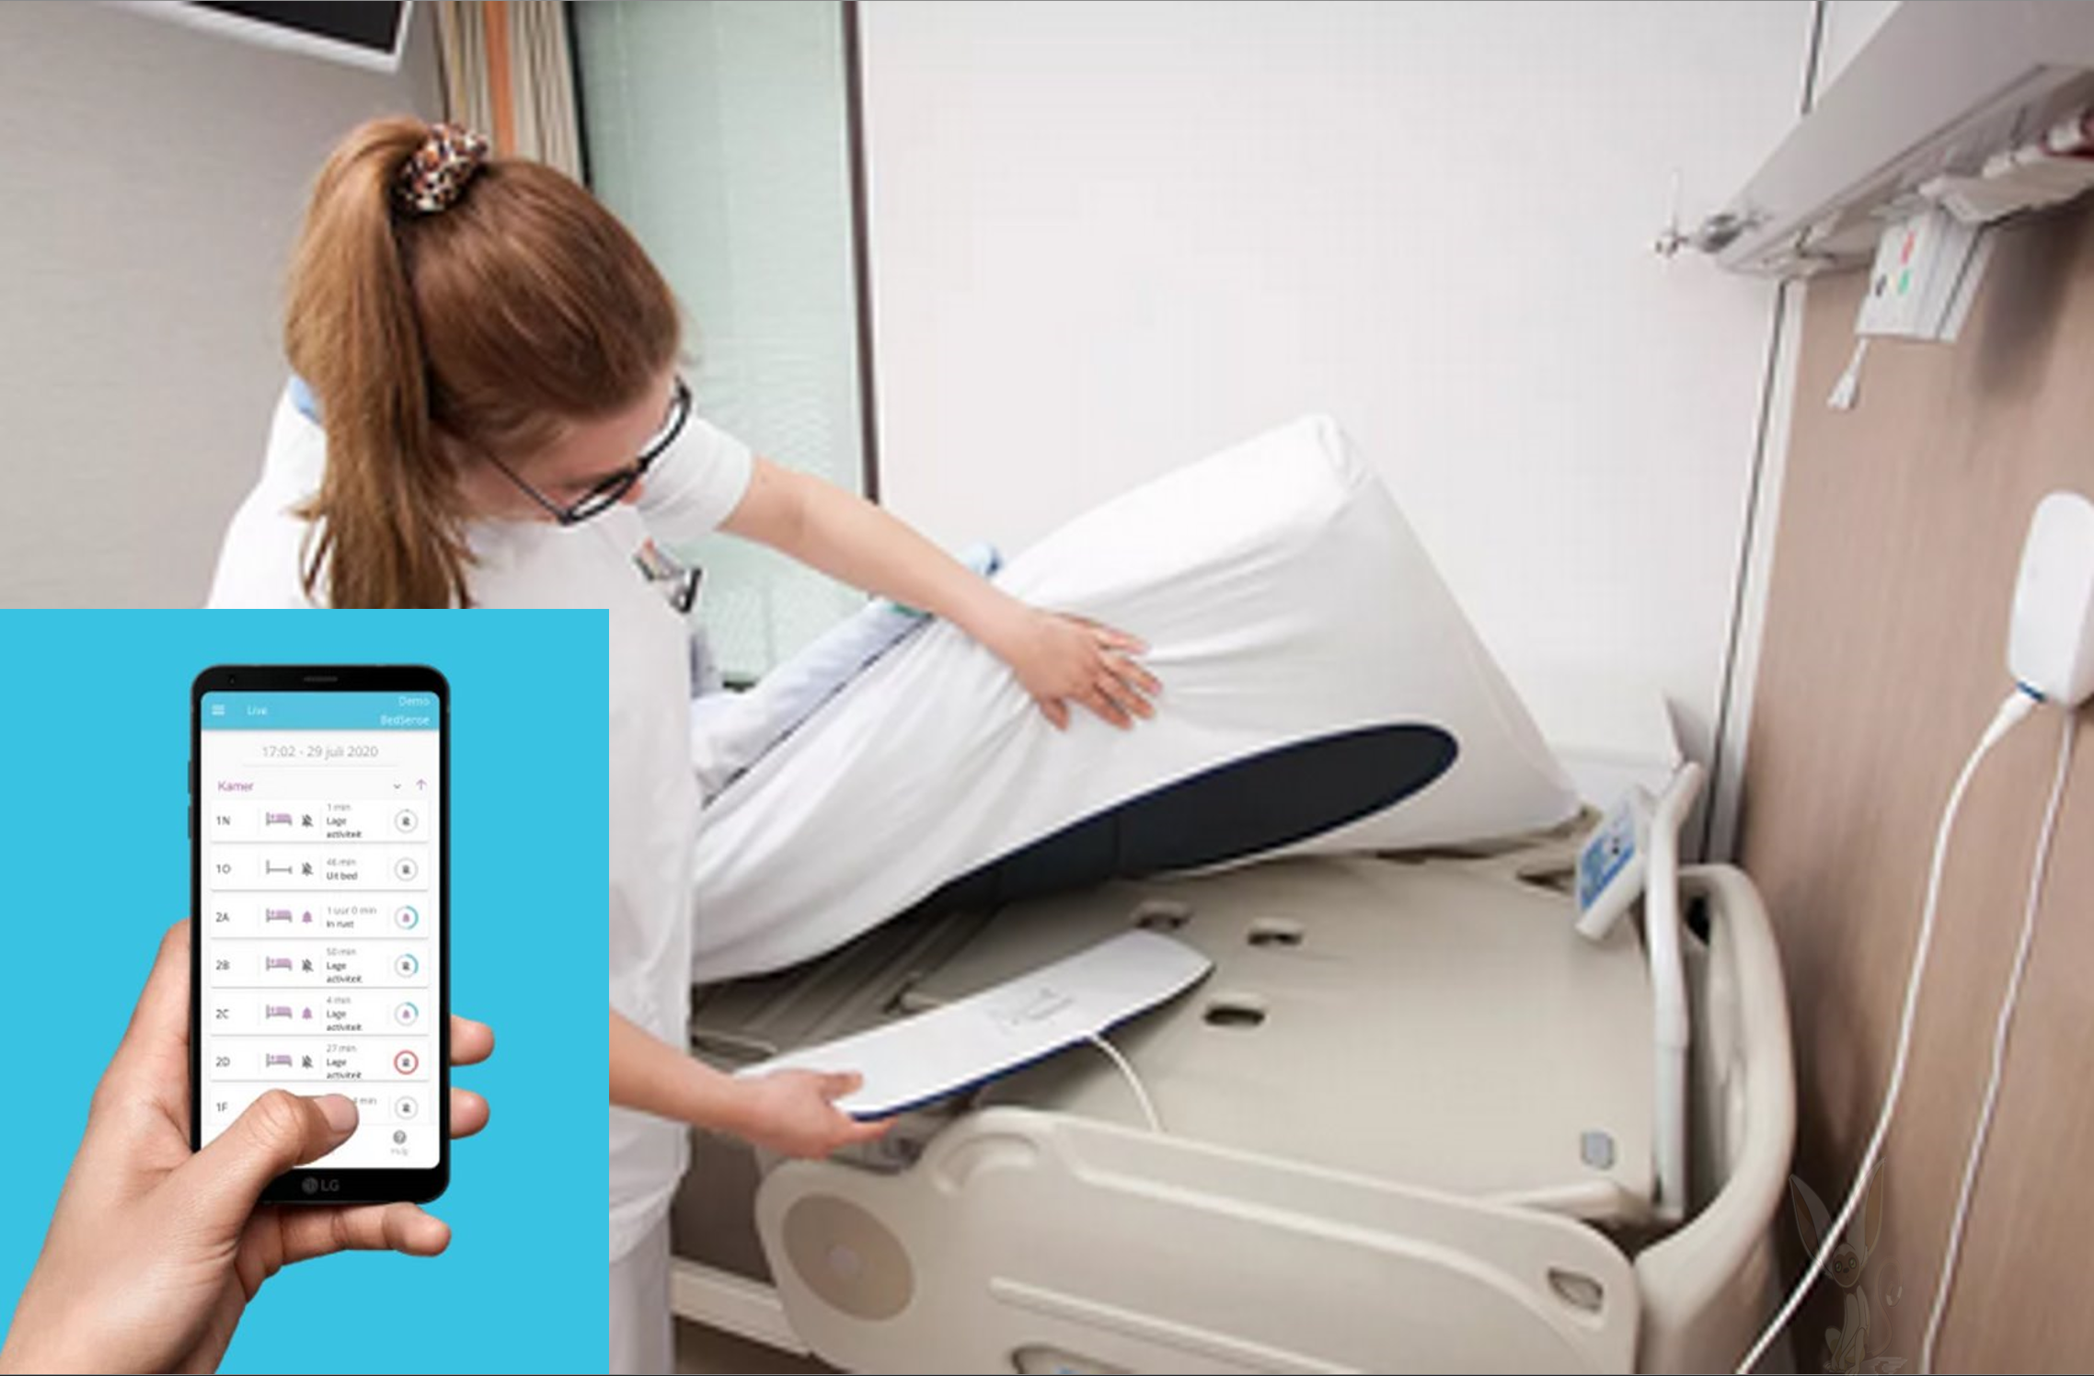
The project
Momo Medical is a start-up located in Delft
BedSense
Multiple sensors are located underneath the mattress
Goal 1 : Have less false positives
Goal 2: Predict when a patient is getting out of bed

Slide 4
What did we do?
This week our focus was still on feature engineering
Created a feature script that detects big spikes in the pressure sensor values.
Created a script that filters out situations in which people are sitting longer than 30 seconds before leaving bed.
Made the average and variance of the pressure values more stationary in the trainings set
Added last weeks features to the model
Tested certain combinations of features to get the best result.

Slide 5
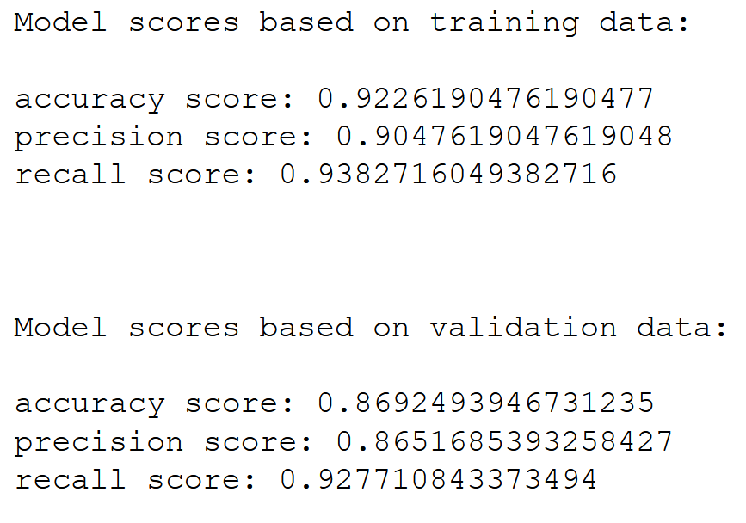
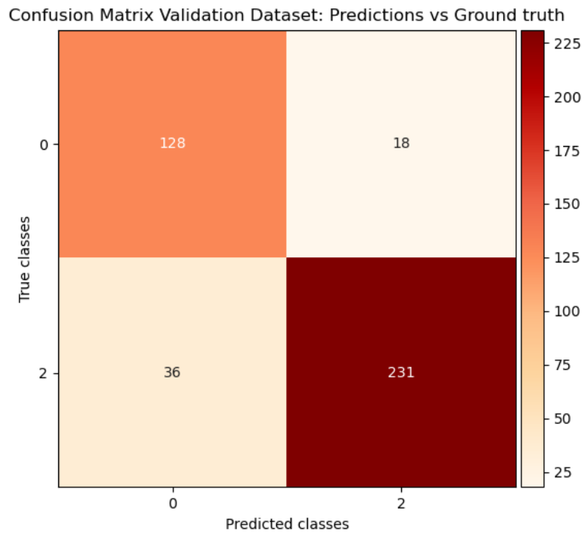
Predictions 10 seconds before

Slide 6
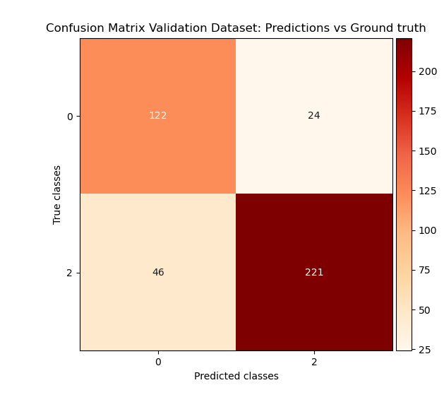
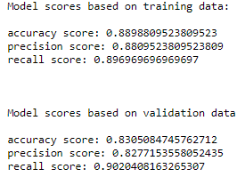
Predictions 30 seconds before

Slide 7

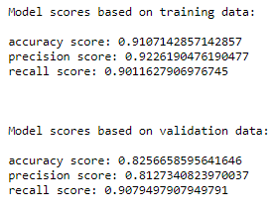
Predictions 60 seconds before

Slide 8

What did we do?
Continued with our paper:
Written abstract and data cleaning part

Slide 9
What are we going to do?
Finish fourrier transform of the piezo sensors
Create script to make real time predictions and visualizations
Make our dataset more stationary
Recursive feature elimination with SelectKBest as a guideline

Slide 10
Questions?

